Slide 1
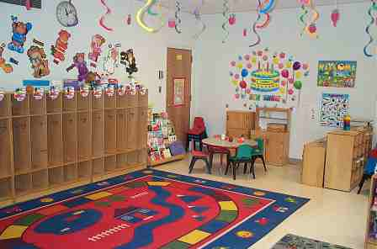
Classroom Management strategies for teachers
School Resource Center- Abuja.
www.src-ng.com

Slide 2
What is classroom management?
It’s the core of a teachers’ role in a school.
Classroom management is the skill/ability to handle the diverse behaviors found in every student and classroom.
Managing disruptive or challenging actions before they escalate.
Using all available resources to bring out the best in each child, having the highest expectations.

Slide 3
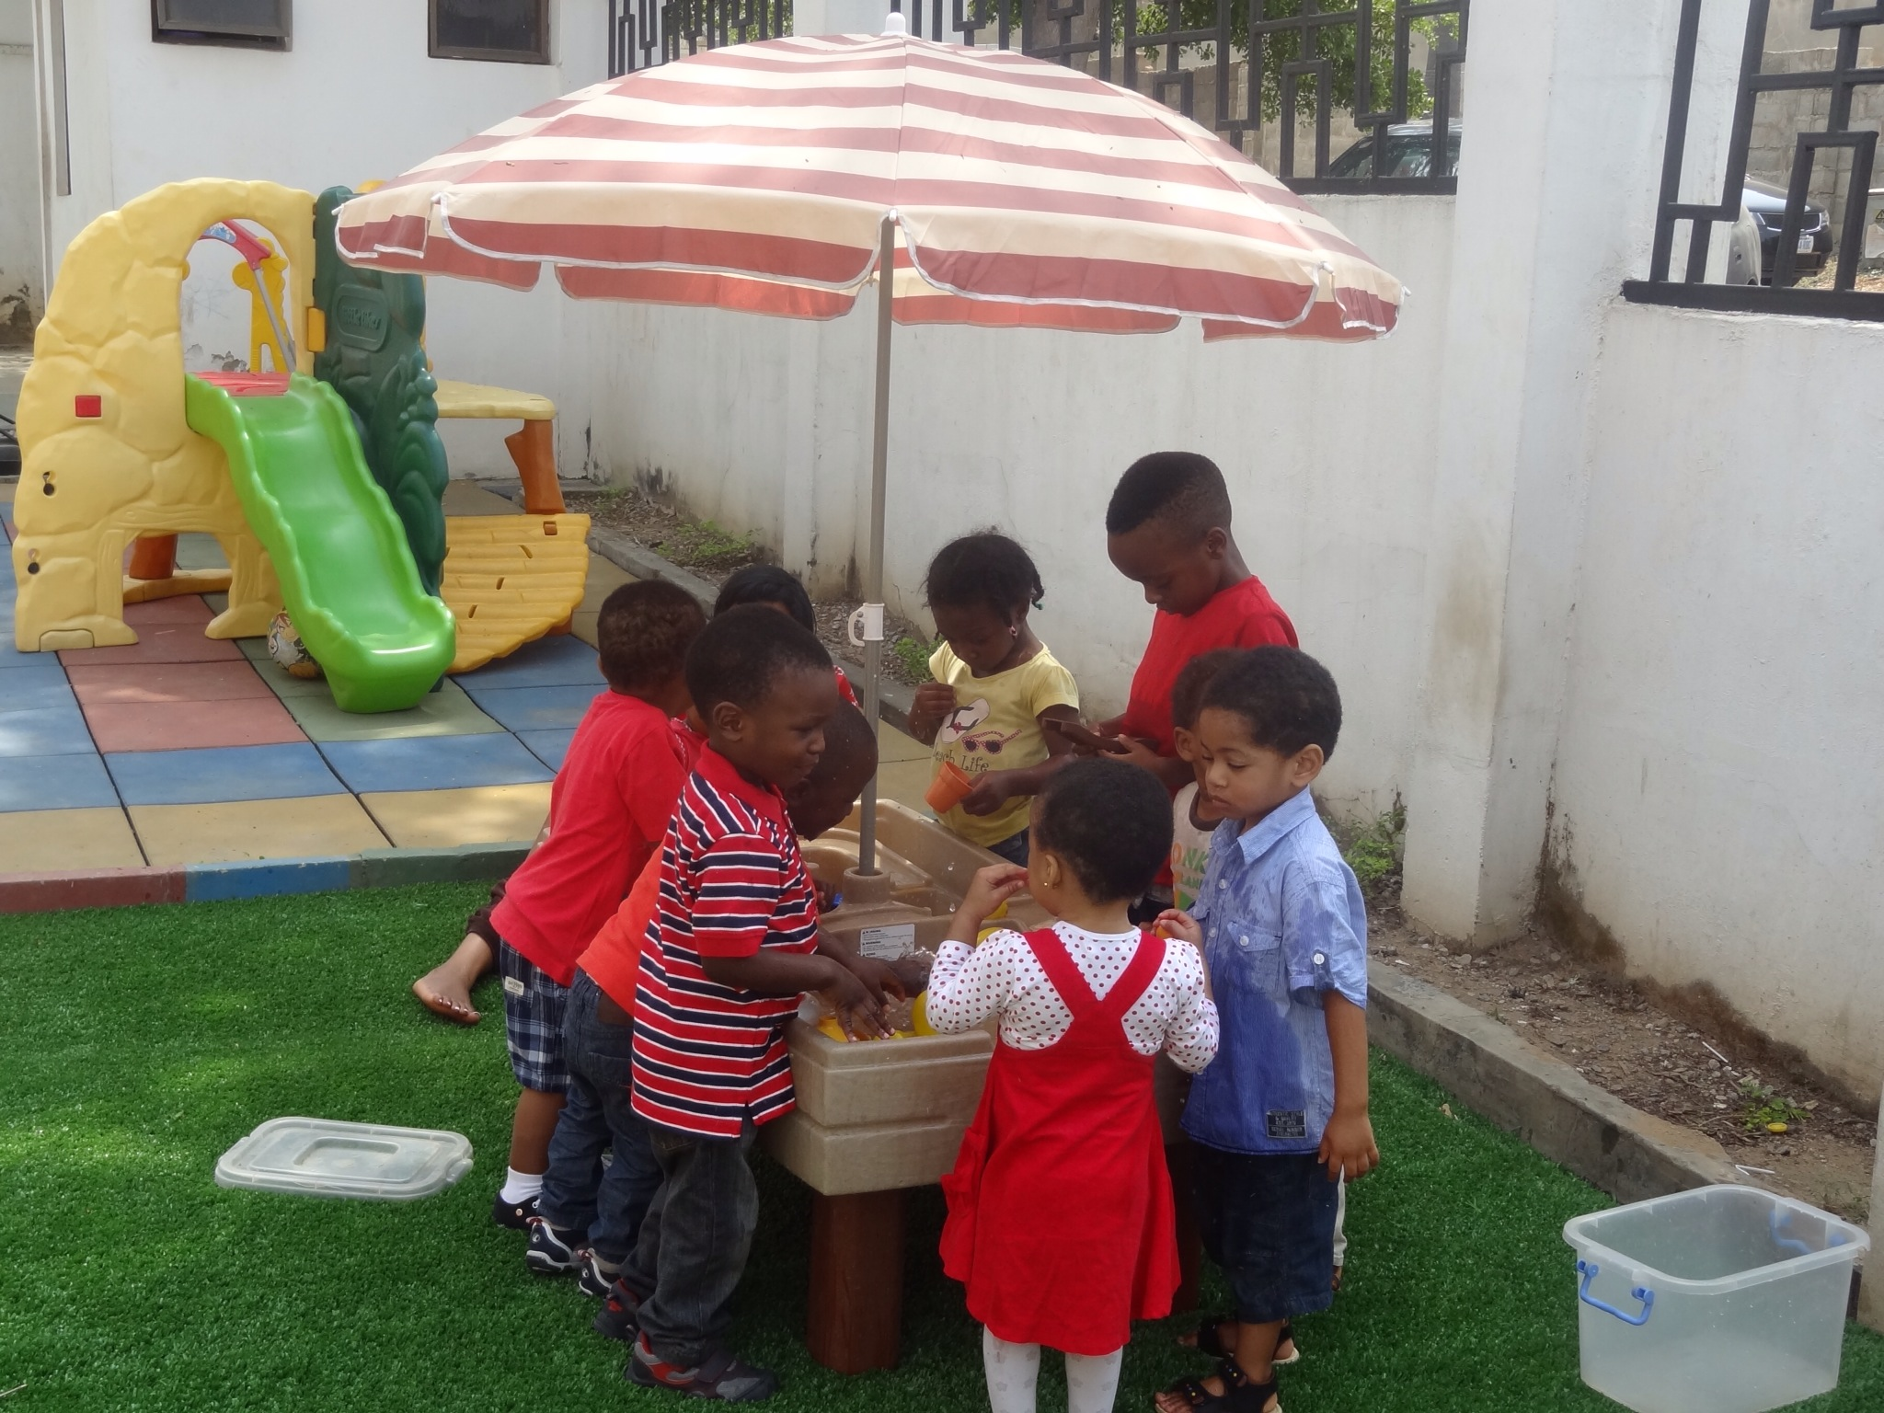
Contd..Classroom management
“Good instruction is now known by researchers to be the first line of defense in behavior management.”

Slide 4
Strategies for effective classroom management: 1) Setting up the classroom

Slide 5
Setting up the classroom
Carpet areas
Type of shelves
Walking areas
Teachers desks
Windows
Lighting
Sound and ambience
Accessibility
Table arrangements
Seat colors, labelled

Slide 6
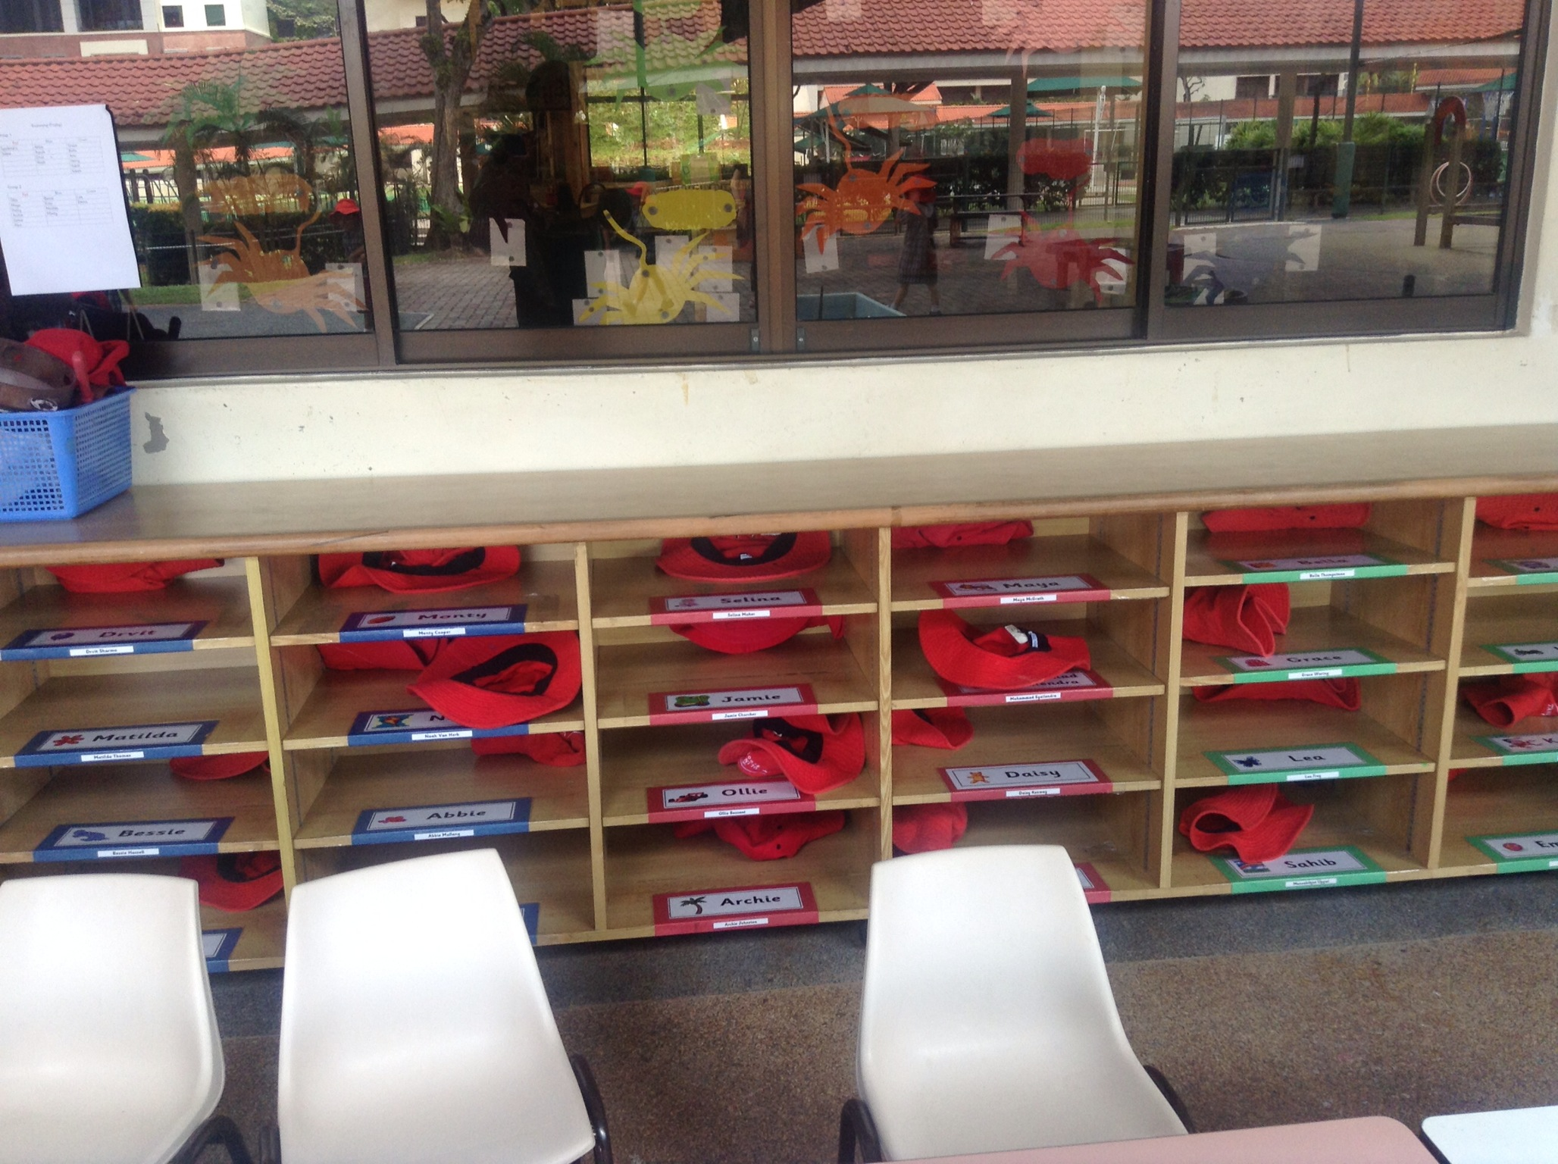
2.)
Organizing your classroom resources
Low shelves
Labelled items
Class signs (drop homework here, reflection corner)
Storage baskets, plastic boxes

Slide 7
3)
Establishing routines and procedures
Arrival time
Class meetings (weekend news, weather, calendar time, news, class tasks)

Slide 8
Contd..Establishing routines
Daily schedule
Interest or learning centers
Homework and home circulations
Home time

Slide 9
4)
Creating learning spaces
What does your class environment say to others?

Slide 10
5)
Fostering independence
Accessibility to class resources
Taking care of their own needs (shoes, remembering home communications, relaying messages, and so on)
Taking the initiative

Slide 11
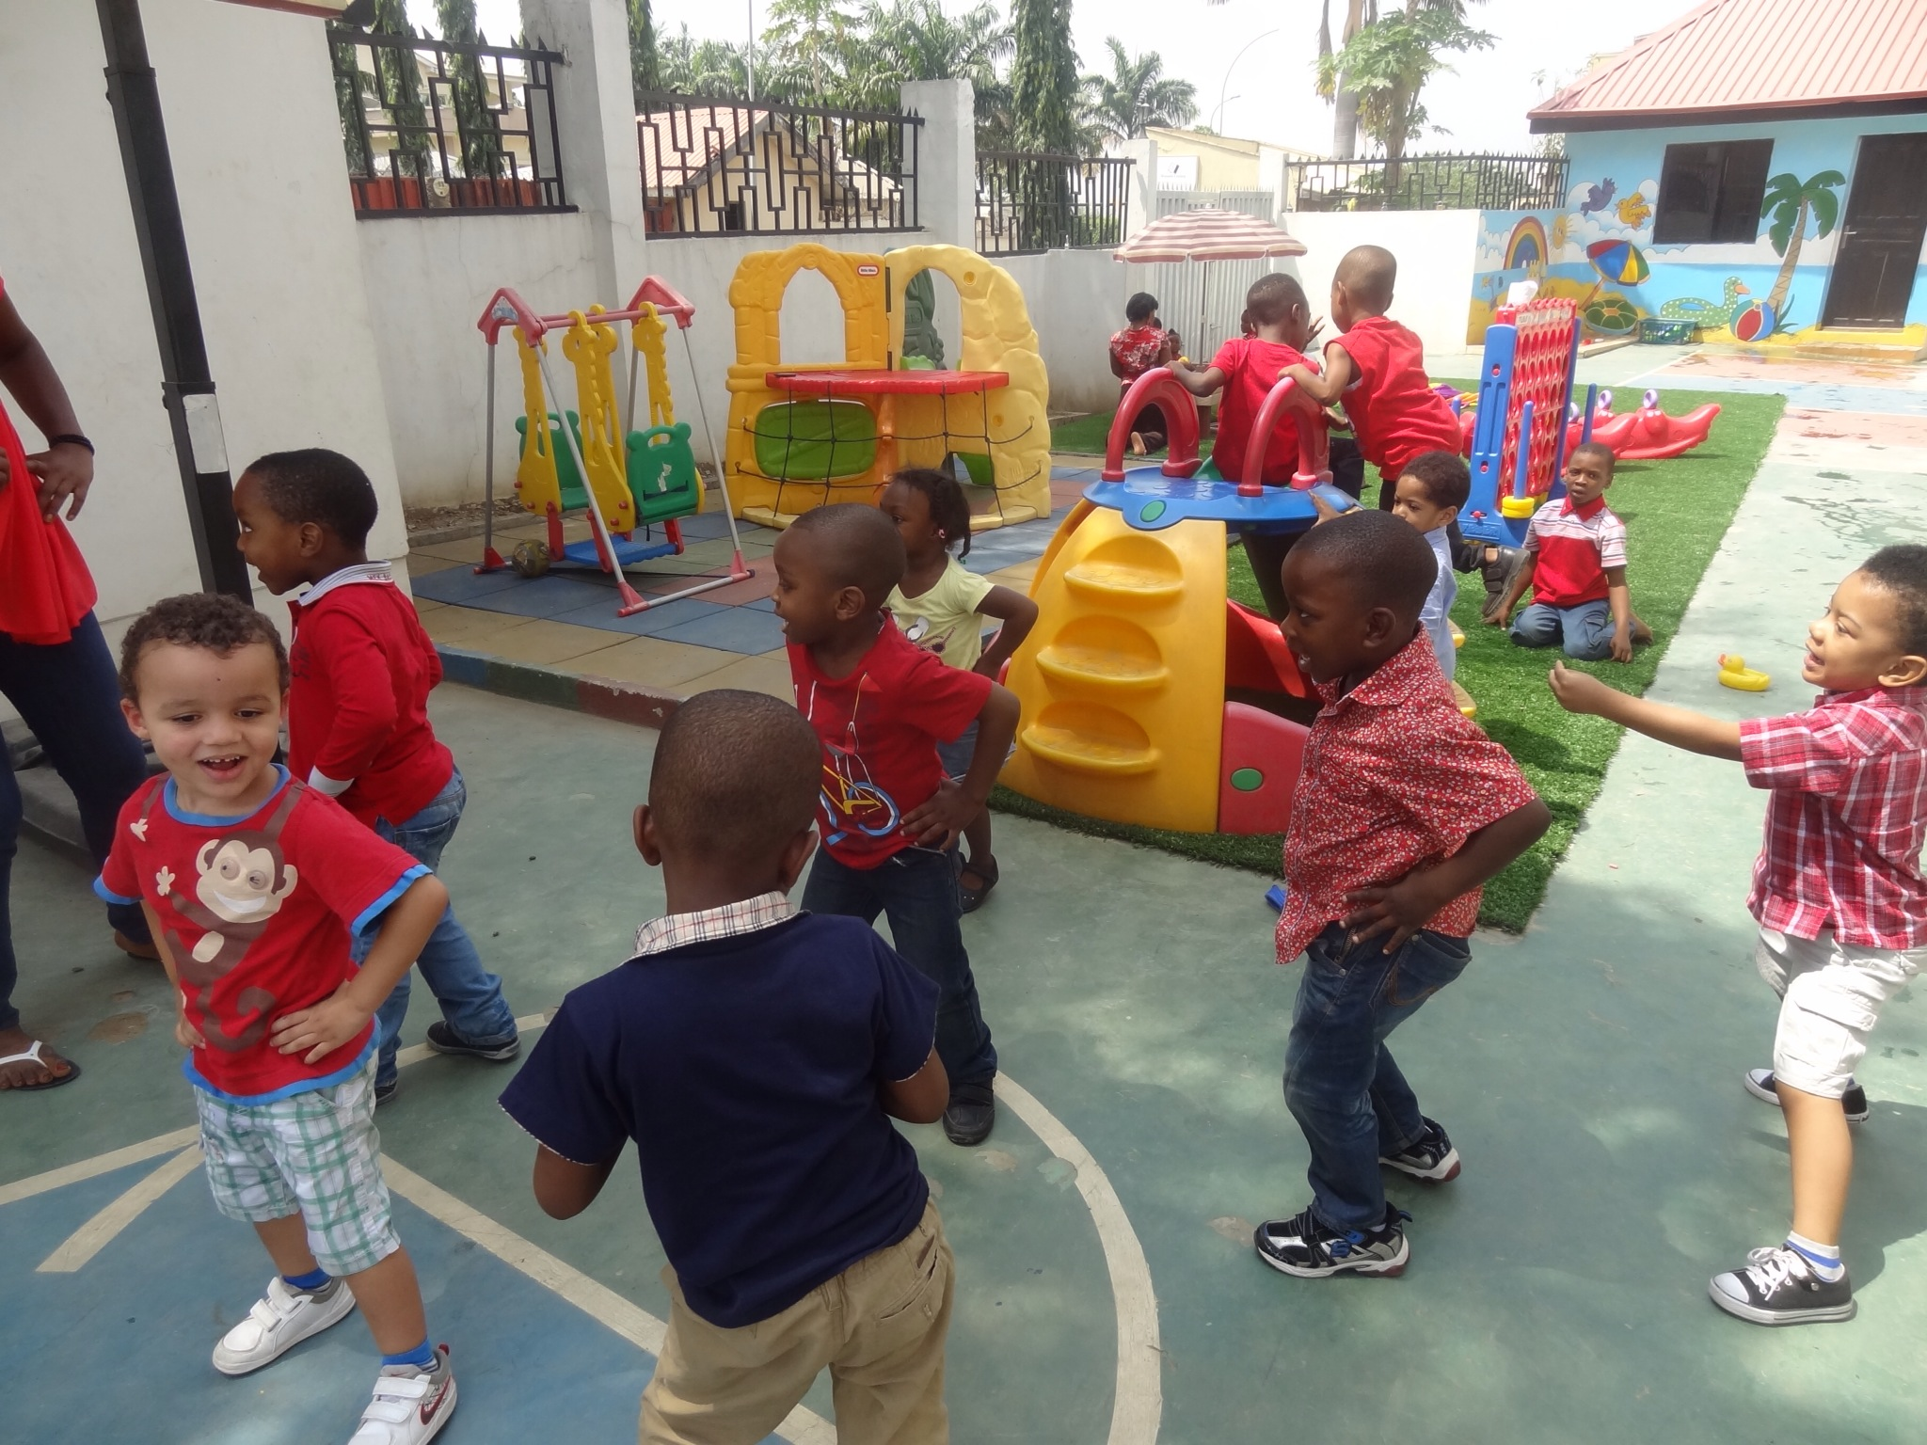
6)
Promoting positive relationships- building community
Creating positive peer relationships
Positive teacher- student relationship is essential to having a smooth flow of learning in the classroom

Slide 12
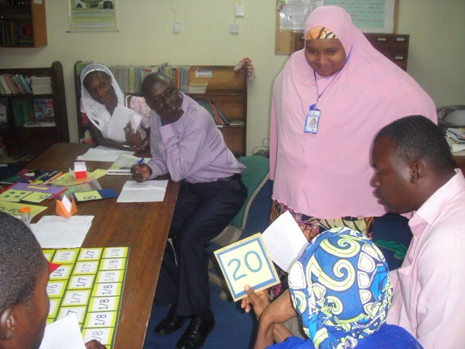
Working with parents- as partners
Parents know (or should) know their own children more than we do. As teachers, a strong partnership between home and school is needed to ensure the child is meeting expectations.

Slide 13
7)
Keeping your class in order

Slide 14
Behavior management and intervention strategies
Attention signals
Proximity control
Reward the positive
Plan seating arrangements
Give time limits
‘Choose your battles
Prepare for transitions
Repeat, repeat, repost and reinforce rules!!

Slide 15
Contd…behavior management
White board ticks
Hierachy reactions
Correct the actual behaviour

Slide 16
8)
Engaging instruction
Differentiating instruction
Let students participate actively in lessons
Plan lessons carefully, knowing your learners

Slide 17
9) Keep things professional
Stay calm
Correct with dignity and preserving self-esteem
Be fair, consistent
Show equality, treat them with same measure
Know your boundaries

Slide 18
10) Develop standards for classroom behavior
We need to teach students to follow rules and procedures (examples of untidy children, chewing gum, BYOD policy, no show homework, etc)

Slide 19
Effective Classroom management must be practiced and reflected on.
THANK YOU!!

